Slide 1
NEW HORIZONS
Subjects, Pathways and Choices available in Vocational Education 2012
Vocation or Job Preparation
Trade Training
Ready 4 Work

Slide 2
THE VOCATIONAL HSC
Job Preparation HSC:
HSC with VET Subject(s)
70 Hour Workplacement
Trade Training HSC (SBAT):
School Based Apprenticeship
School Based Traineeship
Ready 4 Work HSC:
Project based learning
Learning journals
VET Subjects
Work Experience
Literacy, Numeracy and Computing
As 2012 model currently operates

Slide 3
Vocation or Job Preparation HSC

Slide 4
Job Preparation HSC
VET – Vocational Education and Training.
VET Courses – skills training for jobs.
Two types:
SVET – School delivered VET courses
Board Developed (Category B – ATAR)
Board Endorsed (Non ATAR)
TVET – TAFE delivered VET courses
Non category (some exceptions)
For selected students only

Slide 5
VET - SVET Courses
SVET – School delivered Vocational Education & Training.
Two types:
1. Board Developed Courses (Category B – ATAR)
2. Board Endorsed Courses (Non ATAR)
AQF Accreditation – Certificate I and Statement of Attainment towards Cert II. Use for articulation into TAFE courses.
Work Placement 70hrs for Board Developed – SVET courses.

Slide 6
SVET Courses
Board Developed – Eligible for an ATAR
Business Services –SVET
Construction –SVET
Entertainment Industry – SVET
Hospitality Operations –SVET
-Food and Beverage
-Commercial Cookery
Information Technology –SVET
Metal and Engineering – SVET
Primary Industries (Horticulture) - SVET
Retail Operations – SVET
Board Endorsed Courses – Non ATAR
Music Industry Foundation
Furniture Making
Visual Arts and Contemporary Art
To count towards an ATAR
YOU MUST sit the HSC Exam
Remember: You can only have
ONE Board Developed Category B
Course contribute to your ATAR

Slide 7
VET - TVET Courses
TVET – TAFE delivered Vocation Education & Training.
Board Developed Courses – Accounting, Tourism & Primary Industries – Horticulture, Automotive, Electrotechnology.
Board Endorsed Courses – Hairdressing, Plumbing, Fitness, Children’s Services, Animal Care, Beauty Therapy.
BDC TVET – 2 year course.
BEC TVET – Generally 1 year course.
Attendance : Tues 2-6pm. Bus to TAFE Campus $2.10.
Must be committed to course despite this being an ‘extra subject’.
TAFE Applications are due to your Campus Careers Adviser on Friday 10th August 2012.
TAFE Application close 7th September 2012 for 2013 courses.

Slide 8
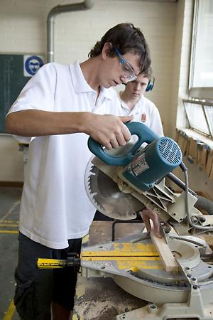
Trade Training HSC

Slide 9
Trade Training HSC
HSC + AQF Qualification + Paid Job
School based until the end of Year 12
12 month Traineeship – completed part time over 2 years.
First year of an Apprenticeship – completed part time over 2 years.

Slide 10
School Based Traineeships
Areas : Retail / Hospitality / Business Services / Horticulture / IT Construction / Metals / Animal Care
Work Component : 100 paid days over 2 yrs.
Structure = HSC + Cert II (VET) + Work
Possible ways an SBAT might take shape:
HSC – English + 3 other subjects
Study VET subject relevant to traineeship at school (or)
1 school day at TAFE or Tues afternoon 2-6pm
1 school day at Work

Slide 11
School Based Apprenticeships
Areas : Construction / Automotive / Electrotechnology / Hospitality / Hairdressing
Work Component : 100 paid days over 2 yrs.
Structure – HSC + Cert III (VET) + Work
HSC – English + 3 other subjects
1 school day at TAFE
1 school day at Work (work in holidays)
Complete the first year of the Apprenticeship.

Slide 12
Finding An Employer
A student needs to have an employer to make a traineeship or apprenticeship happen.
School has limited opportunities.
Use existing employer if casually employed.
Tip - Start making enquiries:
Use family / friends / sporting networks
Ask around, get word of mouth happening

Slide 13
Key Points for SBAT’s
Students must complete schooling to the end of Year 12.
Must make a commitment to an employer – formalised through a Training Contract
Must maintain attendance and performance at school. This may in fact require extra effort because of time away from school.
Will work during school holidays – 1 week.
For SBAT application information
and enrolment – See your Careers Adviser!

Slide 14
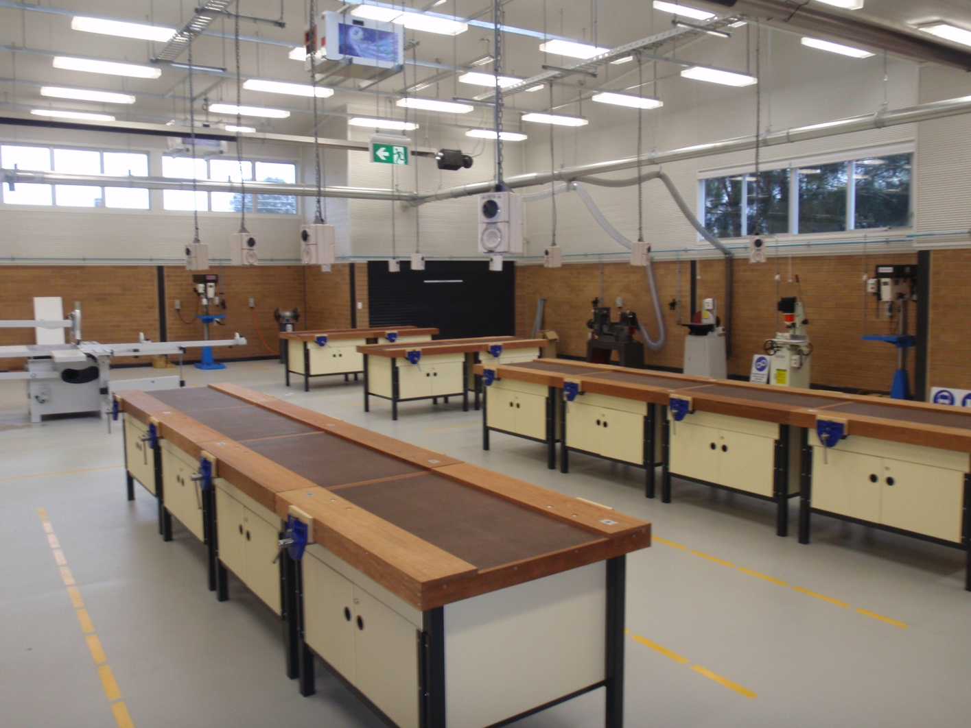
Ready 4 Work HSC

Slide 15
Ready 4 Work HSC
Alternative Vocational HSC for students wanting to leave school for employment either before the age of 17, on turning 17, or deciding to stay on to complete their HSC.
Designed to build work related skills and develop a thorough resume and portfolio that showcasing abilities.
Project based learning through integrated courses:
Construction
Work Studies
Furniture Making (?)
Work related studies in:
Literacy
Numeracy
Computing
3 Days Per Week
Integrated into projects plus 2 Focus Days

Slide 16
NEW HORIZONS
VET: Vocational Education & Training
So if I decide to do a VET Course, how is it different from other courses…

Slide 17
SVET Courses
Board Developed – Eligible for an ATAR
Business Services –SVET
Construction –SVET
Entertainment Industry – SVET
Hospitality Operations –SVET
-Food and Beverage
-Commercial Cookery
Information Technology –SVET
Metal and Engineering – SVET
Primary Industries (Horticulture) - SVET
Retail Operations – SVET
Board Endorsed Courses – Non ATAR
Music Industry Foundation
Furniture Making
Visual Arts and Contemporary Art
To count towards an ATAR
YOU MUST sit the HSC Exam
Remember: You can only have
ONE Board Developed Category B
Course contribute to your ATAR

Slide 18
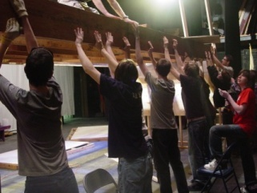
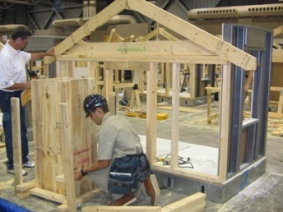
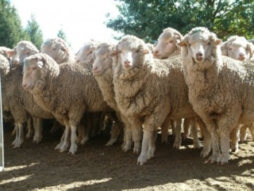
What you need to know about....
Vocational Training Courses
Skills and knowledge required by industry
VET Courses & the HSC
Dual accreditation –
HSC
AQTF qualification
Employability skills
ATAR option – YOU MUST ELECT TO SIT THE OPTIONAL
HSC EXAMINATION

Slide 19
What you need to know about....
Assessment tasks/events provide students with the opportunity to show their skills and knowledge
“Competence” means a student can perform tasks to the level required by industry
Competent / not yet competent
Vocational qualifications
Statement of Attainment
Certificate I, II or III

Slide 20
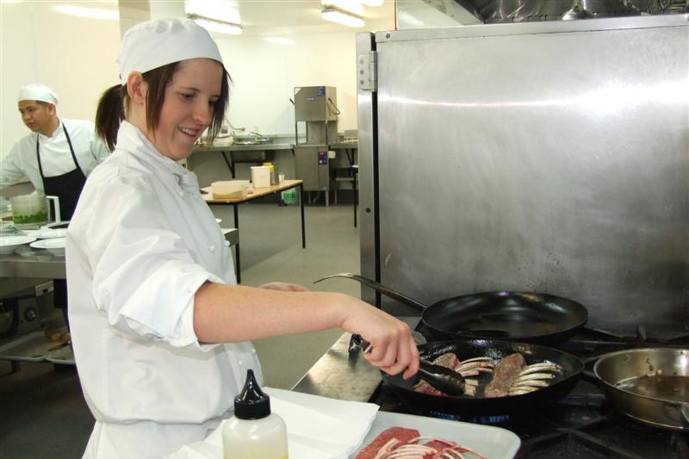
What you need to know about....
Results from assessments
recorded by teacher
sent to BOS
reports
available from your teacher
Examinations
evidence of assessment competence
evidence for BOS if undertaking optional HSC exam

Slide 21
Workplacement
Mandatory 70 hours
Organised by a Workplace Service Provider (WSP) - Youth Connections
Details and arrangements provided by your teacher and your local WSP Coordinator
Students are not paid
If you do not complete workplacement you will not have the course recognised by the Board of Studies. This may mean that you will not receive your HSC.

Slide 22
Course Costs
This includes the cost of materials used in class.
Other costs may include:
safety clothing / uniforms
equipment
work placement travel
A refund may be considered depending upon the reasons for withdrawal from the course and the amount of the course completed

Slide 23
VET AWARDS
NSW Training Awards
Career Links
Hunter Valley Youth Express
WorldSkills

Slide 24
Questions

Slide 25
What happens now…
Visit The Entrance Campus school website – Google ‘The Entrance Campus’
Click on ‘Subject Choices For 2013’ link – then the ‘Subject Selection Portal’ link.
Check out the subject information, watch the subject videos and access the subject forum before deciding on subjects.

Slide 26
What happens now…
Choose subjects online using your login password. This password will be sent to your DET Email.
If you do not receive an email you can see your Careers Adviser, Year Advisers or Deputy Principal for your login code.
Carefully select your subjects in preferred order (most desired to least desired).
Don’t forget you will need to choose some ‘extra subjects’ just in case a subject in your ‘Top 6’ does not run or there is limited room available.
Choose carefully: Once you have submitted online, you can not change your subjects or preferences until interview day.

Slide 27
Questions

